Slide 1
INVESTMENTS
Week 7 and 8: Fixed Income
Vikas Raman

Slide 2
Outline
Types of bond
Bond Pricing
Price quotation
accrued interest
yields
Term structure
spot and forward rates
arbitrage
Bond price volatility
maturity and duration
modified duration
Convexity

Slide 3
Types of Bond
A bond is a security where the pay-out is pre-determined
defined face value or principal that is repaid at maturity
defined stream of interest or coupon payments
Issuer:
generally sovereign or agency or corporate
may be guaranteed by parent or sponsor
Interest generally fixed or floating (tied to some rate like LIBOR)
Liquidity

Slide 4
Innovations in the Bond Market
Growing importance of markets
many debt obligations are converted into traded bonds
private risks are also being packaged into bonds
Asset backed securities:
bank or building society lends money to company or individual
bank then has promised stream of cash flows
sells cash flows to a special vehicle that finances itself by issuing bonds
most risks (default, pre-payment) borne by bond holders, though some retained (moral hazard)
Other risk transfer
credit default swaps, catastrophe bonds, commodity bonds
We will focus for the present on more traditional market, ignoring credit and liquidity issues for now

Slide 5
Bond Definitions
Bond: a security issued as promise to repay a loan
The loan is paid off in a fixed number of payments.
Face value: the amount of the loan to be repaid
Coupon: a payment to the holder of the bond at a specified date.
Example: U.S. Treasury notes pay coupons semi-annually.
Coupon rate: the ratio of the coupon payment to the face value.
Example: A 2-year, $10,000 face value U.S. Treasury note with a 5% coupon rate would pay four $250 coupons at six-month intervals and the $10,000 at the end of two years.
Bond Indenture: the contract between the bondholder and the issuer. These are very complicated for corporate bonds.
Zero-Coupon Bond: a bond that pays no coupons.

Slide 6
Recap….
Bond Valuation Formula:
C = Coupon Payment; F = Principal Payment; r = Discount Rate; n = maturity of the bond
Price or Present Value of a Bond = PV of Coupons + PV of Final/Principal Payment.
Because Coupons are regular (end of the period) payments, we can use the Present Value of Annuity equation to find the present value of Coupons

Slide 7
Recap….Semi-Annual Interest Payments
When Bonds pay semi-annual coupons:

Slide 8
Recap….Semi-Annual Interest Payments
Instead of paying annual coupons, the bond pays semi-annual coupons:
An example....
Value a Bond
Par value = $1,000
Maturity = 7 years
Coupon rate = 8%
r = 6% per year

Slide 9
Recap….Bond Premiums and Discounts
r > Coupon Interest Rate
P₀ < par value
=
DISCOUNT
r = Coupon Interest Rate
P₀ = par value
=
PAR
r < Coupon Interest Rate
P₀ > par value
=
PREMIUM

Slide 10
Bond Quotes
Price you pay is quoted price plus accrued interest – the share of the coupon you will receive at the next coupon date attributable to the period before you owned it
you are quoted the clean price of $96.50 for an 8% 3-yr bond that pays semi-annually
you buy it 36 days after a coupon date
accrued interest is $100 x (.5*8%) x 36/180 =$0.80
you pay the dirty price of $97.30

Slide 11
Why bother with clean price?
If the dirty price is what you have to pay, why bother with quoting a clean price?
Suppose interest rate is 8%, then bond would be worth $100 immediately after a coupon payment
it is worth $104 immediately before the coupon is paid
it is worth $104/(1.04^{D/180}) D days before the coupon is paid
Quoting clean prices makes it easier to compare bonds with different coupons and coupon dates

Slide 12
Interest Yield
Interest yield is computed by dividing interest due by clean price
with 8% bond, interest yield is 8/96.50 or 8.29%
But bond is trading below par (under 100)
so holder to maturity will receive capital gain of 3.50 over three years
appreciation amounts to about 1.20%/yr (ie (3.50/96.50)/3)
total return is about 9.49% (ie 8.29% + 1.20%)

Slide 13
Yield to Maturity
The yield on a bond (redemption yield, yield to maturity) is the discount rate that makes the present value of the bond equal to its (dirty) price
in the example above find y to solve:
use trial-and-error, goal seek, or solver…

Slide 14
Trading Based on YTM
The appropriate yield to maturity, y*, for a bond depends on how risky it is, which as we shall see depends not only on the maturity of the bond, but also on the size of the coupons.
If y < y* sell because you believe the bond is overpriced.
If y > y* buy because you believe the bond is underpriced.

Slide 15
Spot rates and zero-coupon bonds
A spot rate of interest is the YTM on a t-year zero..
Let y_{t} be the spot rate for a t-year zero-coupon (“discount”) bond.
The price of a zero-coupon bond that pays out F at time t is equal to
If we know the bond price, we can figure out the spot rate and vice versa.
The yield-to-maturity can be thought of as a weighted average of the spot rates for each coupon date.

Slide 16
Strips
Bonds are quite complex – the three year bond is a bundle of 6 cash flows
To aid liquidity, Government makes it possible to strip some bonds – unpackaging the individual elements and trading separately
strips are zero coupon bonds
price of bond equals sum of strips – or else arbitrage

Slide 17
Analysis of term structure
The strip or zero coupon yield curve shows the interest rate from now to time t – the spot rate
Knowing the spot rates, we can price any bond
term structure of spot rates
1 year 0.65%
2 years 0.87%
3 years 1.21%
readily price eg 3-yr 2% coupon bond
P =X₁D₁ + X₂D₂ + … + X_{T}D_{T}
X = Coupons (Cash Flow)
D = Discount Factor
D_{n} = 1/(1+Spot Rate_{n})^{n}
=100/1.0121³
=102x0.9646
=2x.9935+2x.9828+102x0.9646

Slide 18
Term Structure of Interest Rates
Even with single issuer, deep and liquid market, yields differ across bonds
called the term structure of interest rates

Slide 19
Interpreting the Term Structure
The yield curve is a good predictor of the business cycle.
Long term rates tend to rise in anticipation of economic expansion.
Inverted yield curve may indicate that interest rates are expected to fall and signal a recession.

Slide 20
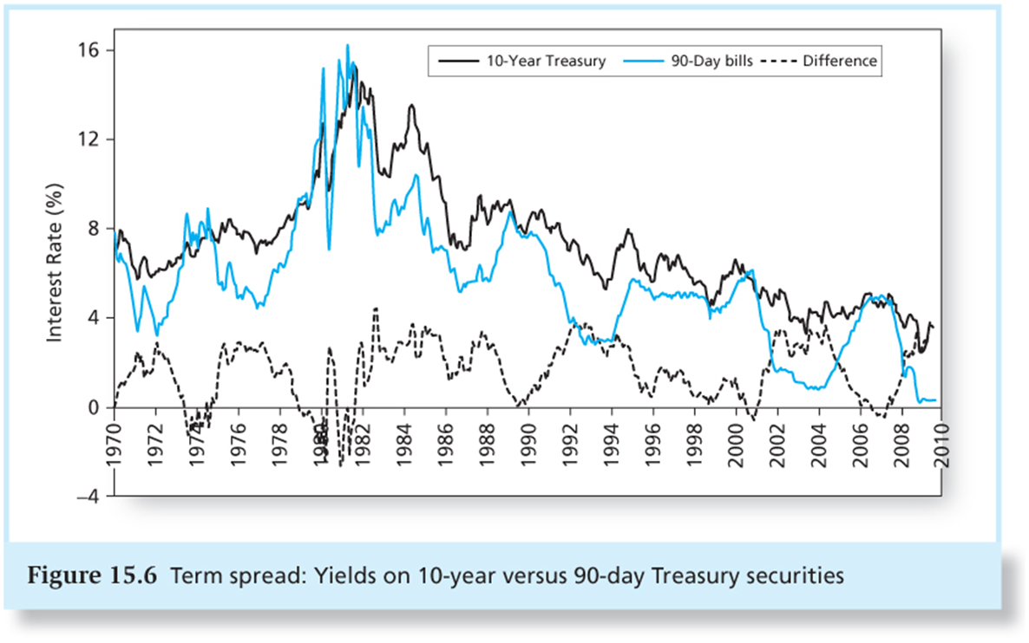
Interpreting the Term Structure

Slide 21
Back to Term Structure
Have inferred term structure from strip prices
no strips in many markets
can readily infer from standard bond prices
In general, have M bonds
bond m promises cash flow of X_{m,t} in year t
it costs P_{m}
if strips did exist, the price of a strip of maturity t would be S_{t}
then the following equations must hold:
P_{m} =X_{m,1}S₁ + X_{m,2}S₂ + … + X_{m,T}S_{T}
Have M equations with T unknowns
can solve exactly if M=T

Slide 22
Back to Term Structure
2 two-year bonds
Bond A pays 4% coupon and trades at $103.76
Bond B pays 8% coupon and trades at $111.52
What are 1-year and 2-year spot rates?
Equation1: 103.76 = 4*D1 + 104*D2
Equation2: 111.52 = 8*D1 + 108*D2
=>D1 = 0.98 and D2 = 0.96
D1 = 1/(1+r1) => r1 = 2.04%
D2 = 1/(1+r2)^2 => r2 = 2.06%
(D = Discount Factor and r = spot rate)
Any assumptions here?

Slide 23
Forward Rate
You can buy/sell a 1-year strip at 99.35 and a 2-year strip at 98.28
Suppose you will get £1m in 1 year and want to fix an interest rate for year 2
sell £1m face value of the 1-yr today
receive £0.9935m; use to buy 2-year strips
can buy 9935/9828 = £1.0109m face value
net effect is you guarantee an interest rate in one year of 1.09%
Can fix now an interest rate for any maturity – this is called a forward rate
Two-Year Spot Rate (r2) = 0.87%
t=0
2019
t=1 (2020)
t=2 (2021)
One-Year Spot Rate (r1) = 0.65%
One-Year Forward Rate (f1) = 1.09%

Slide 24
Spot and Forward Rates Graph
Consider a 3-period coupon bond:
₂f₁
y₁
f₁
f₂
y₂
f₂
y₃
Period 1
Period 2
Period 3

Slide 25
Some formulae
Need to understand and be able to recreate formulae, but doubt if it is worth committing to memory

Slide 26
Forward and future spot
Difference between forward rates and (expected) future spot rates
Forward Rate: 1 year rate between 2020 and 2021 fixed in 2019
Expected future spot rates: 1 year spot rate between 2020 and 2021, but expected in 2019 and to be revealed in 2020
Two-Year Spot Rate (r2) = 0.87%
t=0
2019
t=1 (2020)
t=2 (2021)
One-Year Spot Rate (r1) = 0.65%
One-Year Forward Rate (f1) = 1.09%

Slide 27
Forward and future spot
Is it a good idea to lock in a rate of 1.09% in 1 year?
if the one year spot rate next year is 0.5%, you will look clever
if it is 2% you will look silly
Rough view:
bond market is highly liquid
many players (borrowers and lenders) who are not that fixed on a particular maturity
little “inside” information; many smart analysts
so forward rate unlikely to be seriously out of line with market expectations of future spot rates

Slide 28
Clienteles
There are preferences. If the Expectations Hypothesis holds, forward equals expected future spot, and investors will match their needs
pension funds will hold long dated
investors with liquidity needs will hold short
Supply is important too
borrowers will match maturity to cash flow needs, and reflect risk management concerns
Government issuance integrated with monetary policy
But if supply and demand don’t match prices will adjust
if liquidity is important to investors and securing long term finance important for borrowers, there will be a liquidity premium
on average short rates will be lower than long rates
forward rates will be higher than expected future spot rates
f_{n} = E(r_{n}) + liquidity premium

Slide 29
Bond Prices and Interest Rates
Suppose you hold a 10-year 5% coupon bond in your portfolio
currently interest rates are 5%, and the bond is at par (100)
Interest rates generally rise to 6%
the value of your bond falls to
the cash flow remains the same
the expected return on your money has gone up
Are you made better or worse off by the rate change?
on a mark-to-market basis, worse off
if funding a long-term liability, the loss is offset by a fall in the value of the liability

Slide 30
Interest Rate Sensitivity
Price P is a function of the yield y on the bond
Differentiating:
but we don’t want £ change in price per 1% change in rates, but % change in price

Slide 31
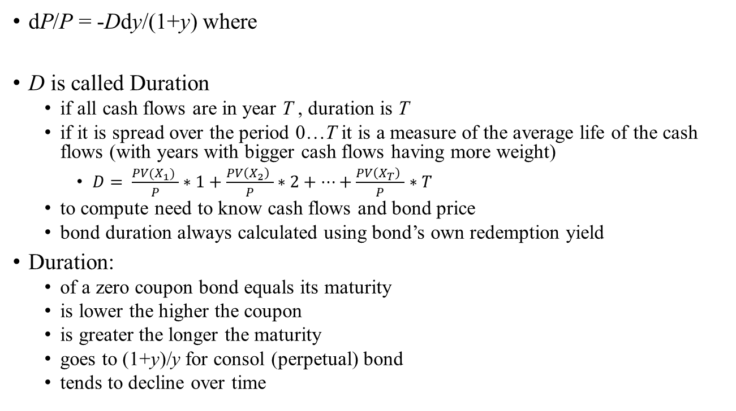
Duration
dP/P = -Ddy/(1+y) where
D is called Duration
if all cash flows are in year T , duration is T
if it is spread over the period 0…T it is a measure of the average life of the cash flows (with years with bigger cash flows having more weight)
$D= \frac{PV(X_{1}) }{P}∗1+\frac{PV\left(X_{2}\right) }{P}∗2+…+\frac{PV\left(X_{T}\right) }{P}∗T$
to compute need to know cash flows and bond price
bond duration always calculated using bond’s own redemption yield
Duration:
of a zero coupon bond equals its maturity
is lower the higher the coupon
is greater the longer the maturity
goes to (1+y)/y for consol (perpetual) bond
tends to decline over time

Slide 32
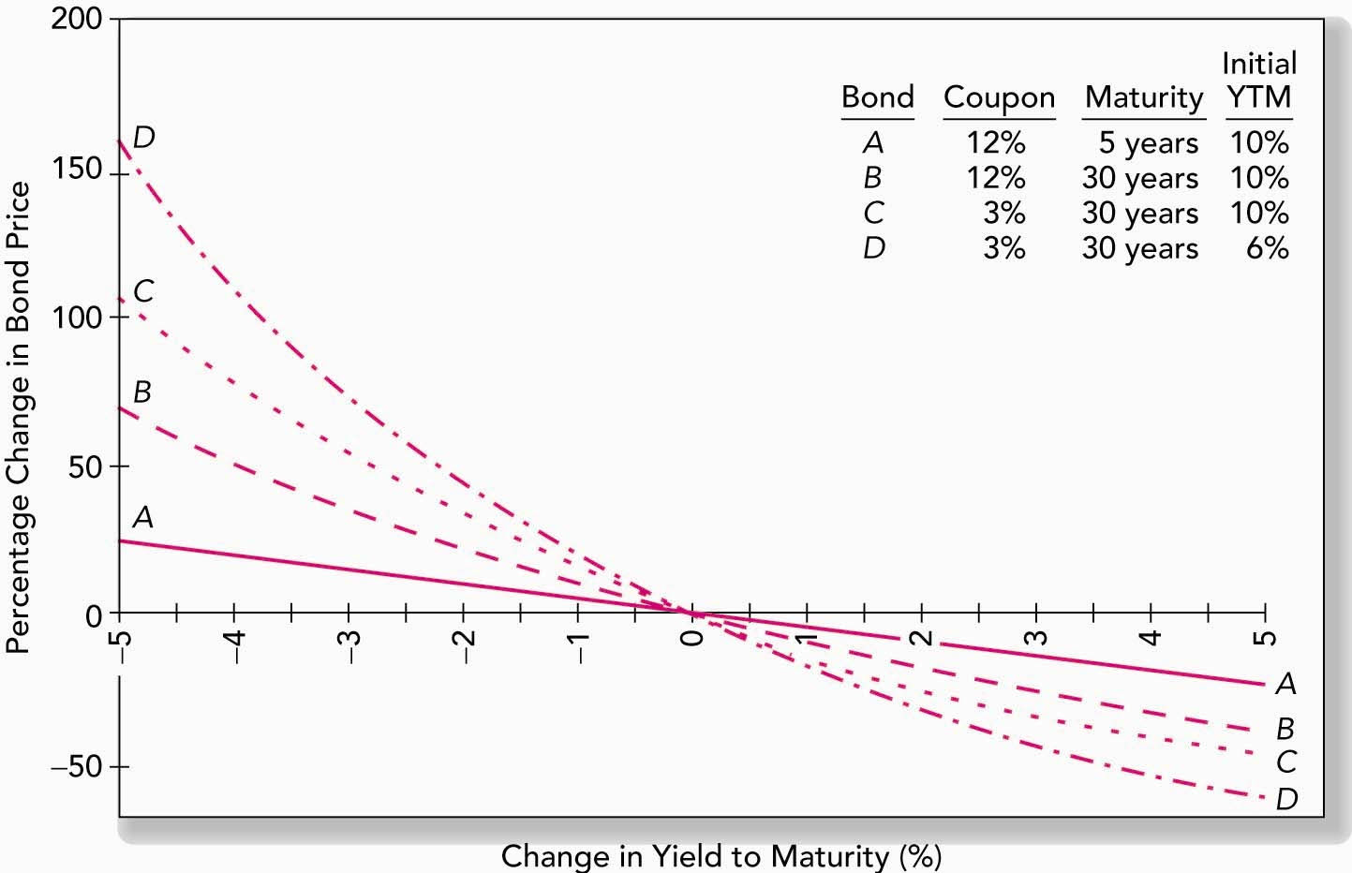
Change in Bond Price as a Function of Change in Yield to Maturity
Which bonds have higher duration?

Slide 33
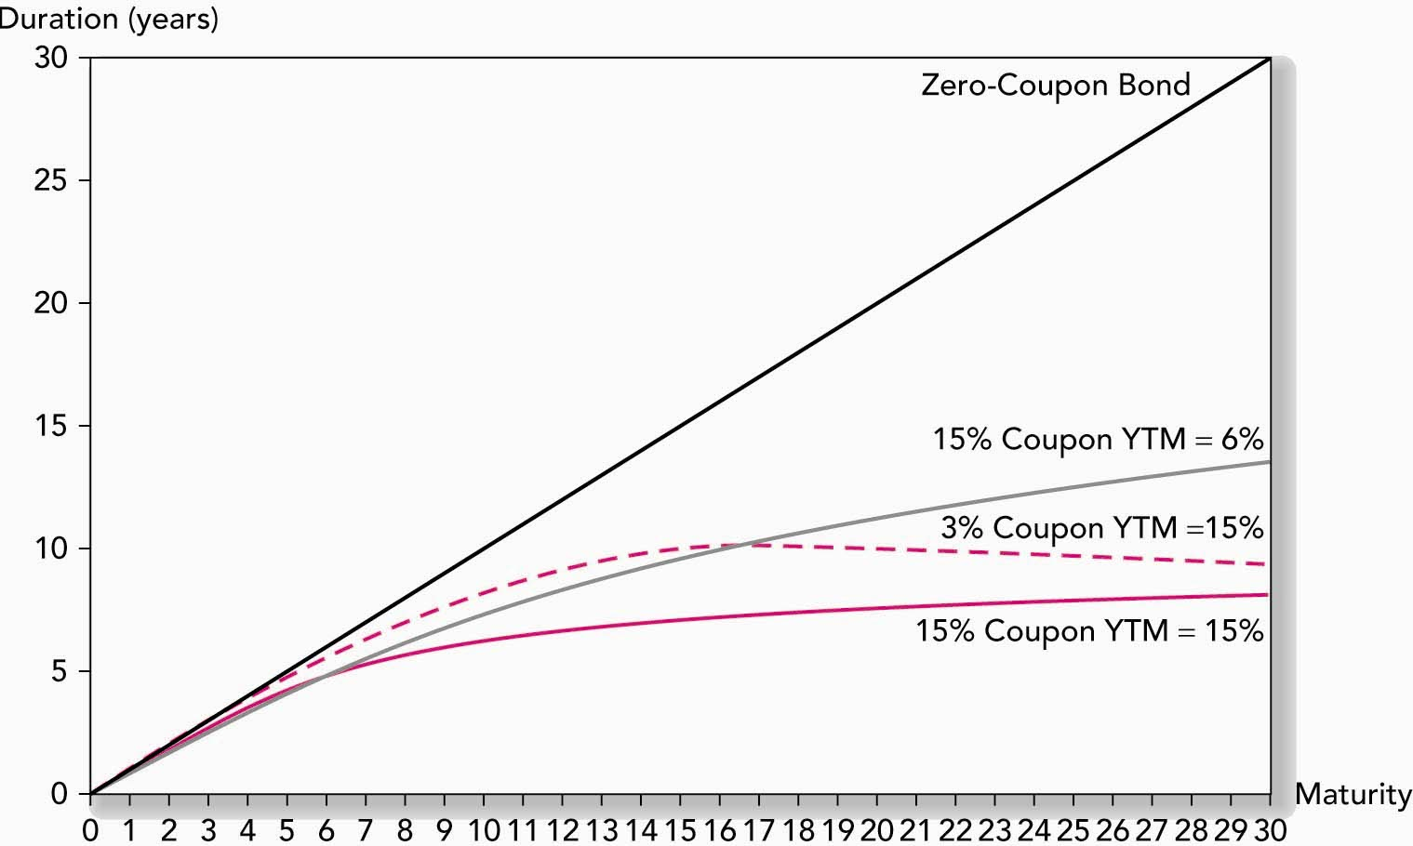
Bond Duration versus Bond Maturity

Slide 34
A very useful measure
Duration is a measure of portfolio’s sensitivity to interest rates
duration of portfolio is weighted average of durations of individual bond holdings
many bond portfolios held to match liabilities; useful to check whether durations match
many financial institutions mismatched (eg banks); use duration as a measure of equity’s exposure to interest rates
Two cautions:
only applies to small changes
when comparing across bonds implicitly assumes that they are subject to same yield change – ie that shifts in the yield curve are always parallel

Slide 35
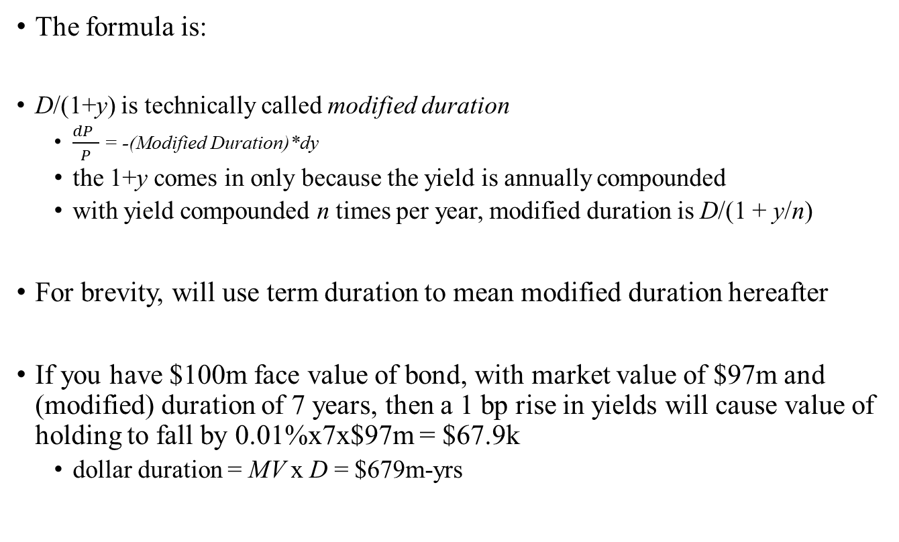
Duration, Modified Duration and Dollar Duration
The formula is:
D/(1+y) is technically called modified duration
$\frac{dP }{P}$ = -(Modified Duration)*dy
the 1+y comes in only because the yield is annually compounded
with yield compounded n times per year, modified duration is D/(1 + y/n)
For brevity, will use term duration to mean modified duration hereafter
If you have $100m face value of bond, with market value of $97m and (modified) duration of 7 years, then a 1 bp rise in yields will cause value of holding to fall by 0.01%x7x$97m = $67.9k
dollar duration = MV x D = $679m-yrs

Slide 36
Floating Rate Notes
Floating rate note pays coupon equal to current short-term interest rate
e.g. 10 year FRN paying LIBOR quarterly
if quarter begins today (“reset date”) and 3-month LIBOR rate is 4.4%, then coupon paid in three months time is £1.10/£100 nominal
Like a deposit that always pays going interest rate
so ignoring credit and liquidity issues, will trade at par (face value), at least at reset date
so bond will be worth £101.10 at next reset date whatever happens to interest rates
Price today is £101.10/(1+y/4)^{4t} where t is time to next coupon and duration is t/(1+y/4) – which is close to 0 - even though maturity is ten years

Slide 37
Immunisation
Suppose portfolio contains many assets with values A₁, A₂ … and corresponding durations d₁, d₂ …
and liabilities have value L and duration d^{L}
then portfolio is immunised – ie protected against small changes in interest rates – if dollar duration of assets and liabilities are the same
A₁d₁ + A₂d₂ … = Ld^{L}
Immunisation works best using bonds that are similar to liabilities being hedged
similar means that yield changes are similar
actual change in value is
-A₁d₁δy₁ -A₂d₂δy₂ …+ Ld^{L} δy_{L}
where δy_{n} is the change in the yield of bond n

Slide 38
Using Duration
Pension fund has liability to pay £100m/year for 20 years
Intends to invest in 4% 10 year bonds and a Floating rate Security
How do we immunize the pension fund’s interest rate risk using duration?
A₁d₁ + A₂d₂ = Ld^{L}
A₁+ A₂ = L
A₁ = ?; A₂ = ?; d₁ = ? d₂ = ? L = ? d^{L}= ?

Slide 39
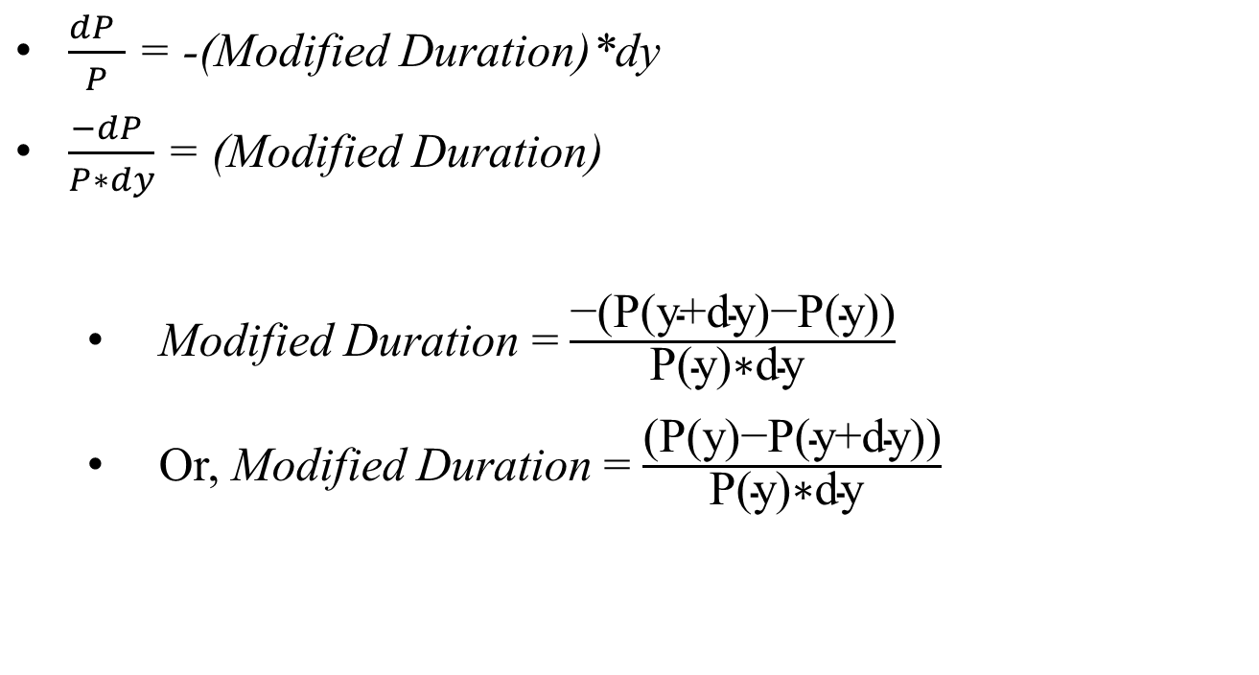
Using Duration
$\frac{dP }{P}$ = -(Modified Duration)*dy
$\frac{−dP }{P∗dy}$ = (Modified Duration)
Modified Duration = $\frac{\text{−(}\text{P}\text{(}\text{y}\text{+}\text{dy}\text{)−}\text{P}\text{(}\text{y}\text{))}}{\text{P}\text{(}\text{y}\text{)∗}\text{dy} }$
Or, Modified Duration = $\frac{\text{(}\text{P}\text{(}\text{y}\text{)−}\text{P}\text{(}\text{y}\text{+}\text{dy}\text{))}}{\text{P}\text{(}\text{y}\text{)∗}\text{dy} }$

Slide 40
Example (continued)

Slide 41
Example (continued)
Computed using formula for annuity: C*((1-(1+i)^-n)/i)
Duration = {(P(5%)-P(5.01%)} / {0.01%xP(5%)}
Computed using formula: C*((1-(1+i)^-n)/i)+100/(1+i)^n
Portfolio chosen so that A + B = L
Ad_{A} + Bd_{B} = Ld_{L}

Slide 42
Using Duration
Pension fund has liability to pay £100m/year for 20 years
present value of liability at 5% is £1246m
duration of liability of fund is 8.47 years
a 1bp fall in interest rates increases liabilities by £1246m x 8.47 x 0.01% = £1.056m
dollar duration of fund is £10.56b-yrs
intends to invest in 4% 10 year bonds, with duration of 7.96 years
if buy £1246m x 8.47/7.96 = £1327m market value of bonds, a 1bp fall in interest rates will cause the assets to rise by £1327m x 7.96 x 0.01% = £1.056m
dollar duration of bonds is £10.56b-yrs
need to borrow £1327-1246m = £81m – floating rate, so duration of debt is roughly zero

Slide 43
Verify valuation

Slide 44
Some implications
With short positions, can match any desired duration
will protect against any small and parallel shift in yield curve
but exposure to changes in slope or curvature of yield curve may be devastating
in example, £-dur of assets was £10.6b yrs
if yield on assets rises 10 bp, but yield on liabilities remains unchanged, lose £10.6m
not inconceivable if eg using gilts for paying liabilities, and hedging using corporates
Note that value of hedged position goes down for large move in either direction
position has negative convexity
you will tend to lose from large moves

Slide 45
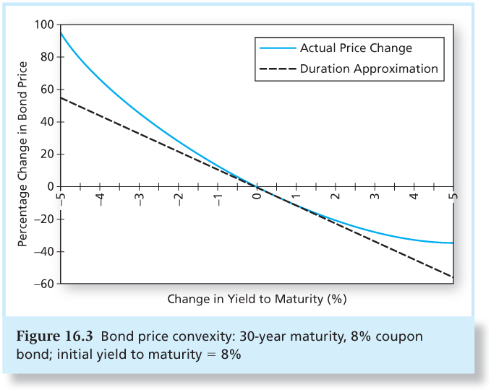
Some implications
%change in prices v/s change in yield should be linear

Slide 46
Convexity
The relationship between bond prices and yields is not linear.
Duration rule is a good approximation for only small changes in bond yields.
Bonds with greater convexity have more curvature in the price-yield relationship.

Slide 47
Convexity
Correction for Convexity:

Slide 48
Convexity
Duration is only a local measure of interest rate sensitivity
For greater precision:
the convexity of a zero coupon bond that matures at time T is T(T+1)/(1+y)²
the convexity of a portfolio is the weighted average of the convexity of components
if matching duration of assets and liabilities is like matching mean time to repay, then matching duration and convexity is like matching mean and standard deviation

Slide 49
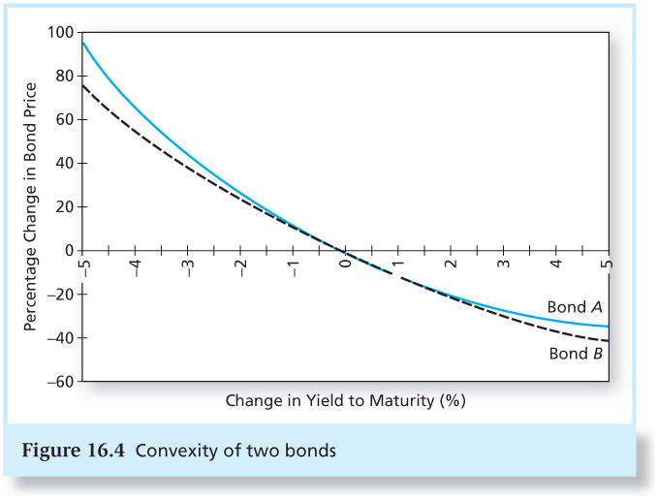
Figure 16.4 Convexity of Two Bonds

Slide 50
Why do Investors Like Convexity?
Bonds with greater curvature gain more in price when yields fall than they lose when yields rise.
The more volatile interest rates, the more attractive this asymmetry.
Bonds with greater convexity tend to have higher prices and/or lower yields, all else equal.

Slide 51
Not all shifts are parallel …

Slide 52
Conclusions
Bond market conventions
accrued interest, clean and dirty prices
running yield and yield to maturity
Term structure
strip or spot yields, and forward rates
pricing all cash flows
arbitrage and its limits
Duration is the key measure of sensitivity to interest rate risk
immunise by matching duration of assets and liabilities
matching convexity protects against large parallel moves, but more important to hedge against changes in slope by 2-factor immunisation
In limit, to remove risk, go for cash flow matching

